Slide 1
P.R. GOVERNMENT COLLEGE (A), KAKINADA
Group: B.Sc. III Year
Subject: Electronics
Semester: 5
Paper : 5
Title of the paper: Microprocessor (Intel 8085)
w.e.f. 2018 - 19 ADMITTED BATCH

Slide 2
Topic : Pin description of 8085 Microprocessor

Slide 3
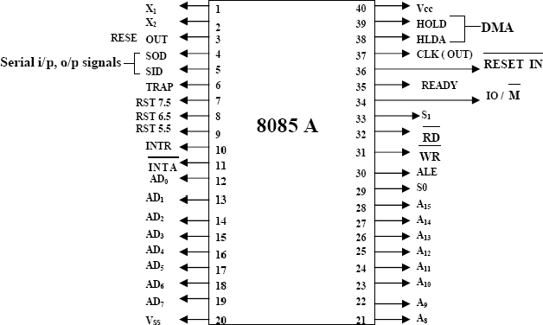
8085 Pin Diagram

Slide 4
The 8085 is an 8-bit general purpose microprocessor capable of addressing 64 k of memory.
This device has 40 pins requires a +5 V power supply and can operate with a 3 MHz single phase clock.

Slide 5
Classification of Signals
All the signals are classified into 7 groups:
Address bus
Data bus
Control & status signals
Power supply and frequency signals
Externally initiated signals
Serial I/O signals
Interrupt signals

Slide 6
Address Bus
The 8085 has 8 signal lines from A₈ – A₁₅ which are unidirectional and used as higher order address bus.
Multiplexed Address & Data bus
The signal lines from AD₇ – AD₀ are bidirectional, they serve for a dual purpose.
They are used as the lower order address bus as well as the data bus.

Slide 7
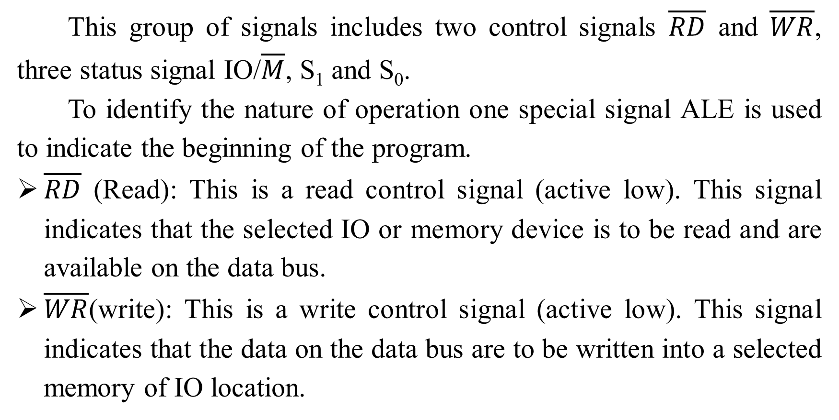
Control and Status signals
This group of signals includes two control signals $\overline{RD}$ and $\overline{WR}$, three status signal IO/$\overline{M}$, S₁ and S₀.
To identify the nature of operation one special signal ALE is used to indicate the beginning of the program.
$\overline{RD}$ (Read): This is a read control signal (active low). This signal indicates that the selected IO or memory device is to be read and are available on the data bus.
$\overline{WR}$(write): This is a write control signal (active low). This signal indicates that the data on the data bus are to be written into a selected memory of IO location.

Slide 8
IO/$\overline{M}$, S₁ and S₀
This is a status signal used to differentiate between IO and memory operations.
When it is high it indicates an IO operation, when it is low it indicates an memory operation.
This signal is combined with read and write to generate IO and memory control signals.
S₁ and S₀ indicate the type of machine cycle in progress.

Slide 9
ALE(Address Latch Enable)
It is an output signal used to give information of AD₀-AD₇ contents.
This is a positive going pulse generated any time the 8085 begins its operation.
When pulse goes high it indicates that AD₀-AD₇ lines are address.
When it is low it indicates that the contents are data.
This signal is used primarily to latch the lower order address from the multiplexed bus and generate a separate set of 8 bit address lines.

Slide 10
Power supply and clock frequency
Vcc: +5 V DC power supply
Vss: Ground reference
X1, X2: A crystal is connected at these two pins having frequency of 6 MHz. The frequency is internally divided by 2.
CLK Out: Clock output signal can be used as the system clock for the other devices.

